Slide 1







MYOELECTRIC TRANSRADIAL PROSTHETIC ARM FOR UPPER LIMB DISARTICULATION
Under the Guidance of,
Mr. Shreeshayana R
Assistant Professor
Department of Electrical & Electronics Engineering
ATME College of Engineering, Mysuru
Presented By,
AKILESH P 4AD20EE003
KARTHIK R 4AD20EE009
LAVANYA G K 4AD20EE010
PROJECT PHASE 2
ATME College of Engineering, Mysuru

Slide 2


Preamble
Statistics
Project Objectives
Methodology and Flowchart
Advantages & Applications
Literature Survey
Field Survey
Problem Definition
Budget Estimation
References
Hardware and Software
Results
Work Done in Phase 1 and Phase 2
CONTENTS
PROJECT PHASE 2
ATME College of Engineering, Mysuru

Slide 3
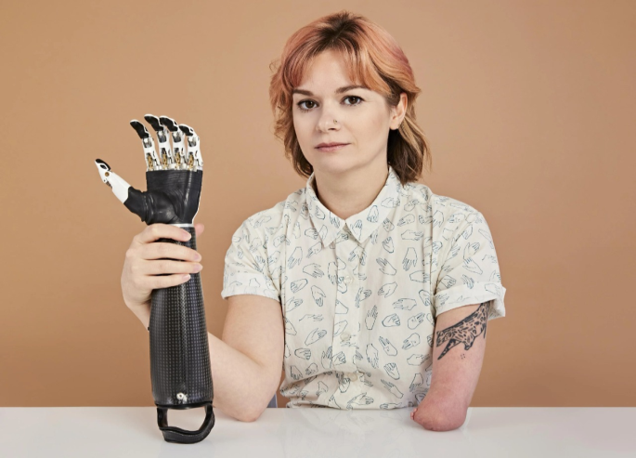
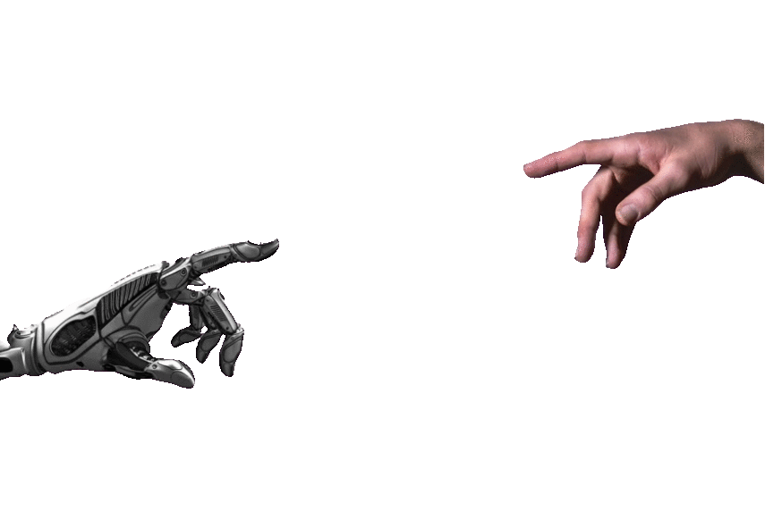
Preamble
Prosthetic Arm
If you are missing an arm or leg, an artificial limb can sometimes replace it. The device, which is called a prosthesis, can help you to perform daily activities such as eating, dressing and many Activities.
Some artificial limbs let you function nearly as well as before.
What is Prosthetic Arm?
The upper extremity prosthesis basically consists of a socket, a method of suspension, a power source, plus elbow and shoulder joints depending on level of amputation.
PROJECT PHASE 2
ATME College of Engineering, Mysuru

Slide 4
Statistics
Distribution of disabled persons by age group by disability in India
The first major limb fitting centre in India was established in Pune in 1944 by the Armed Forces, mainly for use by their own employees.
PROJECT PHASE 2
ATME College of Engineering, Mysuru

Slide 5
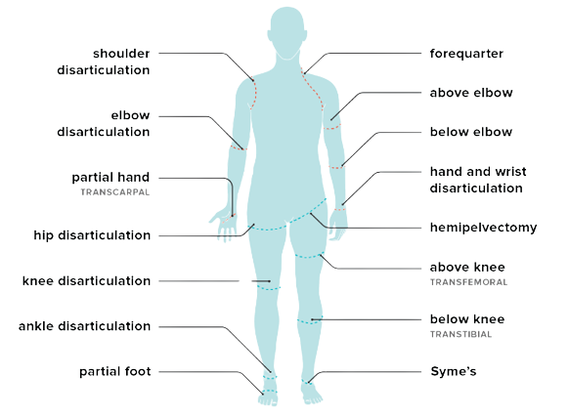
Amputation Types
Amputation is surgery to remove all or part of a limb or extremity (outer limbs). Common types of amputation involve:
PROJECT PHASE 2
ATME College of Engineering, Mysuru

Slide 6
Amputation Causes
Amputations are performed if there is:
Cancerous tumours in the limb.
Frostbite.
Gangrene (tissue death).
Neuroma or thickening of nerve tissue.
Peripheral arterial disease (PAD) or blockage of the arteries.
Severe injury, such as from a car accident.
Diabetes that leads to non-healing or infected wounds or tissue death.
PROJECT PHASE 2
ATME College of Engineering, Mysuru

Slide 7
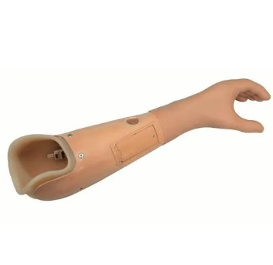
Types of Prosthesis
1. Passive Prosthetic
Passive prostheses are not equipped with any mechanical or electrical part to provide active grasping capabilities. Passive prosthesis can be subdivided into cosmetic and functional.
Cost: ~ 35,000 ₹.
Passive Prostheses
PROJECT PHASE 2
ATME College of Engineering, Mysuru

Slide 8
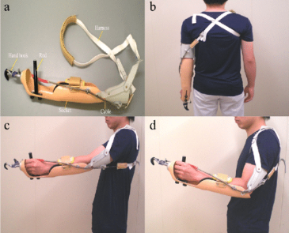
Types of Prosthesis
2. Body- Powered Mechanical Control
Body-powered prostheses are the most commonly used artificial arm. A body-powered prosthetic arm is held in place by suction or by a strap system that rests on your shoulders. A cable and harness system controls the device.
Barriers/Current Problems:
Cost: ~ 50,000 ₹.
Rejection rate 16–58% (often uncomfortable).
Restrict the range of movement of arm.
Difficult to finely control grasp and grip.
Body-Powered Mechanical Control
PROJECT PHASE 2
ATME College of Engineering, Mysuru

Slide 9
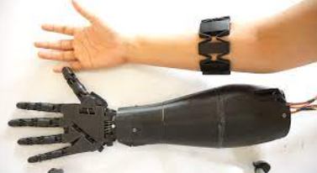
Types of Prosthesis
3. Myoelectric Sensors (Bionic)
Myoelectric prostheses do not require a harness and are controlled by nerves and electrical impulses from the wearer’s residual limb. When we move our muscles, small electrical fields are generated around them, which can be measured by electrodes. They often use two electrode sites to sense two major muscle groups.
Barriers/Current Problems:
Cost: ~ 9,00,000₹ (expensive).
Batteries need to be recharged often.
Lengthy training period to adapt.
Difficult to finely control grasp and grip.
Myoelectric Sensors Control
PROJECT PHASE 2
ATME College of Engineering, Mysuru

Slide 10
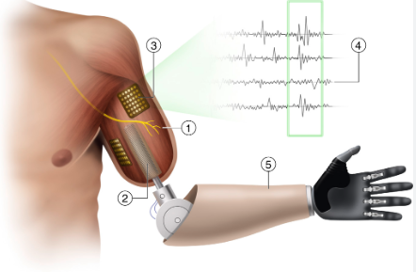
Types of Prosthesis
4. Implanted Myoelectric Sensors (IMES)
The IMES system is a device is used to improve signal quality and consistency of myoelectric signals for prosthetic control. The end caps serve as electrodes for picking up EMG activity during muscle contraction.
Barriers/Current Problems:
Total Cost: ~ 16,50,00₹ to 25,00,000 (very expensive).
Invasive.
Difficult to finely control grasp and grip.
Implanted Myoelectric Sensors Control
PROJECT PHASE 2
ATME College of Engineering, Mysuru

Slide 11
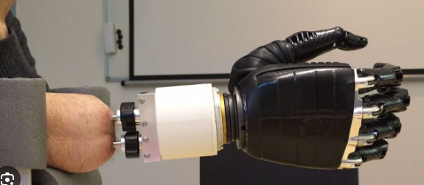
Types of Prosthesis
5. Hybrid Prosthetics
Hybrid prosthesis combines myoelectric operation and body power, allowing for quicker, more controlled movements and versatility. The advantage of this prosthetic type is that it provides the multi-articulating functionality of a myoelectric arm as well as the strength and sensory feedback of a body-powered prosthesis.
Hybrid Prosthetics
PROJECT PHASE 2
ATME College of Engineering, Mysuru

Slide 12
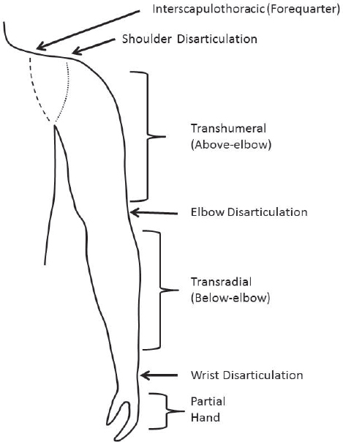
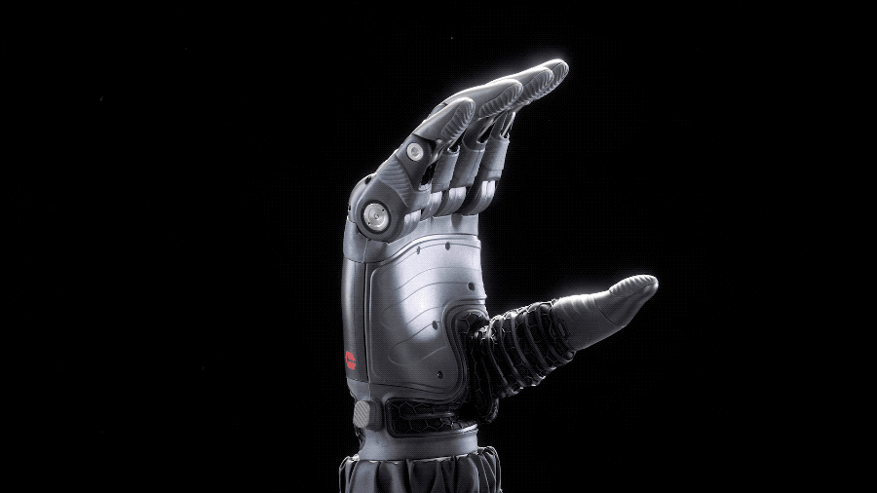
Transradial Arm
What Is Transradial Amputation?
It is the partial amputation of the arm below the elbow, at some point along with the radial bone.
It connects an electronic hand to the muscles in your arm. As the muscles contract, electrodes send a signal to the artificial limb, causing it to move in much the same way as your real hand.
5 Steps to Take before Getting a Prosthetic Limb.
Consult a Doctor
Rehabilitation Centre/ Pvt Manufacturer
Meeting and Discussing fitment, Measuring Fitment
Prosthetic Fitment and Testing
1-3 Months Training and feedback
Transradial Prostheses Arm
PROJECT PHASE 2
ATME College of Engineering, Mysuru

Slide 13
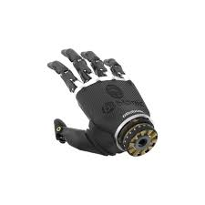
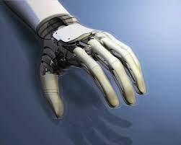
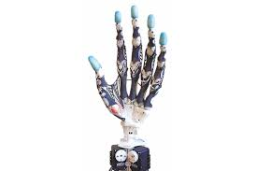
Market Price Comparison of Models
India is a vast country with a large number of individuals in the community with various disabilities. It had been estimated that there are roughly 0.62 amputees in India per thousand populations.
There are currently 0.11 million amputees in India that have suffered below elbow limb loss and almost 16,500 people added about every year.
Approximately 84 percent of persons with Lower Limb Amputation and 56 percent of persons with Upper Limb Amputation are reported.
While the market price of an imported myoelectric prosthetic hand with the said features ranges from Rs 3.5 to 15 lakh.
Commercial Prosthesis
Michelangelo Hand
Rs. 16.70 Lakh
I-limp hand
Rs. 1.45 Lakh
Bebionic hand
Rs. 9.00 Lakh
PROJECT PHASE 2
ATME College of Engineering, Mysuru

Slide 14
Field Survey
We Have visited JSS Hospital, Artificial limb Centre, Department of Orthopaedics, Mysore and we have seen some certain Prosthetic Arms and Leg some of those are listed below:
Cost of the myoelectric prosthetic arm which is around 5lakhs to 16lakhs depending upon the advanced technologies used.
Amputees need to give there another arm length measurement to manufacture the prosthetic arm, during this process they faces difficulty.
The weight of the material used in the manufacture of prosthetic arm is high which is around 1 to 2kg,
Due to high cost of myoelectric prosthetic arm, amputees are going to adopt passive prosthetic arm which cost around ₹50,000.
PROJECT PHASE 2
ATME College of Engineering, Mysuru

Slide 15

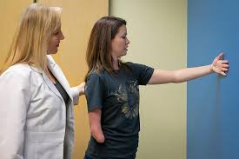
Problem Definition
Problem 1:
Indigenously developed sensor band to pick up signals from stump region of the arm is still a challenge
Problem 2:
Myoelectric control of arm for grasping objects and control of finger movements is still a challenge
Problem 3:
Amputees have consciousness to physically visit the hospital for prosthetic arm purchase/testing or cannot afford the arm.
PROJECT PHASE 2
ATME College of Engineering, Mysuru

Slide 16
Literature Survey
[1] | Cortical correlates of voluntary postural sway with vibrotactile feedback in transfemoral amputees by aayushi khajuria. published: 2023 from ieee.
Inference: From this Paper We Learn, Below-knee amputation and there Loss of somatosensory feedback after amputation inflicts a serious challenge for amputees to achieve postural stability and also to develop yield light weight and compact designs.
[2] | Thumb Controlled Low-Cost Prosthetic Robotic Arm by Amit Hasan Khan, Fairoz Nower Khan, Lamiah Israt, Md. Saiful Islam. Published: 2019 from IEEE .
Inference: From this Paper We Learn, a low-cost robotic arm has been proposed which is affordable to above or below elbow amputees. Using servo motors, Arduino UNO, end effector etc. to construct the proposed system can enable a person to move, grasp and replace objects that are heavy or require both hands to carry.
[3] | Design aspects of a low-cost prosthetic arm for people with severe movement disabilities by Tomasz Kocejko, Radosław Weglerski, Tomasz Zubowicz, Jacek Ruminski, Jerzy Wtorek, Krzysztof Arminski. Published: 2020 from IEEE.
Inference: From this Paper We Learn, the mechanical parts of the designed arm were 3D printed and the designed prosthetic arm is a part of the hybrid interface with eye tracking movement control which Final product is able to freely move an object of a total weight of 1kg.
PROJECT PHASE 2
ATME College of Engineering, Mysuru

Slide 17
Literature Survey
[4] | A 3D-printable Prosthetic Hand Based on a Dual-arm Operation Assistance Model by Taro Shibanoki, Kosuke Jin. Published: 2021 from IEEE.
Inference: From this Paper We Learn, This paper proposes a 3D-printable myoelectric prosthetic hand to enable stable prosthetic control in a series of dual-arm operations. The proposed prosthesis involves a state transition model of dual-arm tasks in daily livings.
[5] | Stiffness Perception using Transcutaneous Electrical Stimulation during Active and Passive Prosthetic Control by Luis Vargas, Helen Huang, Yong Zhu, and Xiaogang Hu. Published: 2020 from IEEE.
Inference: From this Paper We Learn about, Haptic feedback which allows an individual to identify various object properties. In this preliminary study, paper determines that performance of stiffness recognition using transcutaneous nerve stimulation when a prosthetic hand was moved passively or was controlled actively by the subjects.
[6] | A Prosthetic Gripper with Three Opposing Fingers Driven by a Hydraulic Actuator by Yuma Yamanaka and Masahiro Yoshikawa. Published: 2020 from IEEE.
Inference From this Paper We Learn, prosthetic gripper with three opposing fingers driven by a hydraulic actuator without electrical components. The three fingers are controlled simultaneously by pushing the lever of an operating interface mounted on the user’s upper arm on the affected side.
PROJECT PHASE 2
ATME College of Engineering, Mysuru

Slide 18
Literature Survey
[7] | Robotic Arm controlled using IoT application by H. Kareemullaha, D. Najumnissaa, M.S. Murshitha Shajahana, M. Abhineshjayramb, Varshan Mohanc, S. Ayisha Sheerin. Published: 2022 from Elsevier.
Inference: From this Paper We Learn about, design and develop a remotely controlled robotic arm that can be used in applications where the engaging human hazardous environment. It is proposed to design a 3DOF(degrees of freedom) robotic arm with stepper motor which is controlled through Wi-Fi.
[8] | Design and Testing of a Novel, High-Performance Two DoF Prosthetic Wrist by Revanth Damerla, Kevin Rice, Daniel Rubio-Ejchel, Kang Yang, Hongju Guang, Vasil Iakimovitch, Evelyn Sorgenfrei, Shorya Awtar. Published: 2020 from IEEE.
Inference: From this Paper We Learn, design of a novel two Degree of Freedom parallel kinematic prosthetic wrist that incorporates this actuator-transmission combination. This first iteration of the proposed prosthetic wrist meets the target torque, speed, and weight but does not meet the target dimensions or range of motion.
[9] | Testing and evaluation of lower limb prosthesis prototypes in people with a transfemoral amputation: a scoping review on research protocols by Vera G. M. Kooiman, Eline S, Erik C. Prinsen and Vivian Weerdesteyn. Published: 2023 from Journal of Neuro Engineering and Rehabilitation.
Inference: From this Paper We Learn about, development or testing prosthesis prototype testing and reporting calls for the development of a core set of reported participant characteristics, testing protocols, and specifc and well-founded outcome measures, tailored to the various aims and development phases.
PROJECT PHASE 2
ATME College of Engineering, Mysuru

Slide 19
Literature Survey
[10] | Cognitive Workload Assessment of Prosthetic Devices: A Review of Literature and Meta-Analysis by Junho Park, and Maryam Zahabi. Published: 2020 from IEEE.
Inference: From this Paper We Learn, evaluate the effectiveness of a training strategy for reducing cognitive workload(CW) and improving device usability, both task performance and subjective measures should be considered. Based on the literature review, a set of guidelines was provided to improve the usability of future prosthetic devices and reduce CW.
Based on the Literature Survey, We gained the following Insights to Build Our Project
The Prosthetic arm Designs are the advantages to yield light weight and compact designs as well as its easy of manufacture.
The Different arm types (Robotic, Surgical, Bionic, Prosthetic and Static) are analyzed in terms of Resistance, Usage, Flexibility, Cost and Potential.
PROJECT PHASE 2
ATME College of Engineering, Mysuru

Slide 20
Problem Objectives
Objective 1:
To Develop a 3D Printed Myoelectric Transradial Prosthetic Arm to Control Hand Movements.
This is achieved by utilising myoelectric sensor (muscle sensor), Arduino microcontroller and servo motors to control hand movements.
Objective 2:
To Develop a Console Application to Measure the arm dimensions.
This is achieved by using PyCharm and python applications with Cvzone and Kivy interpreter.
PROJECT PHASE 2
ATME College of Engineering, Mysuru

Slide 21





Hardware and Software
Problem Objectives
Software
PyCharm community edition 2023.1.1 | Python 3.7 | Comcol multiphysics | Arduino IDE | Kivy
PyCharm community edition 2023.1.1: Language used: Python Interpreter: CVzone Mediapipe numpy | Python 3.7: Language used: Python to create a data handling, optimizations for script compilation and garbage collection, and faster asynchronous I/O | Comcol Multiphysics 5.6: Used finite element analysis software that allows users to model and simulate physical processes. | Arduino IDE: Language used : C Arduino Software (IDE) - contains a text editor for writing code, a message area, a text console, a toolbar with buttons for common functions and a series of menus. | Kivy: Kivy is an open-source software for rapid development of applications for Linux/OSX/Windows/Android/iOS
PROJECT PHASE 2
ATME College of Engineering, Mysuru

Slide 22
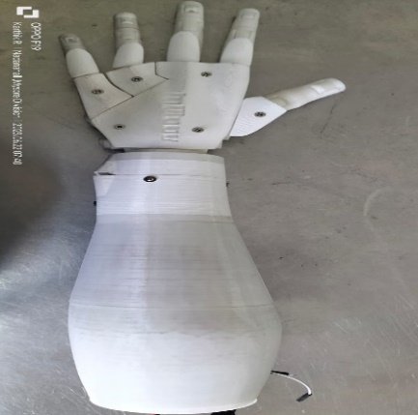
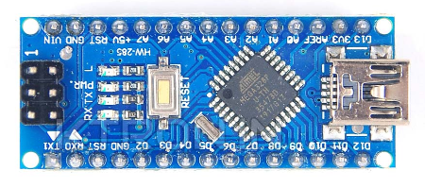
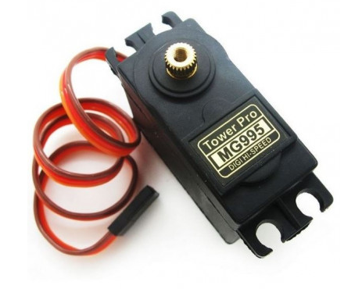
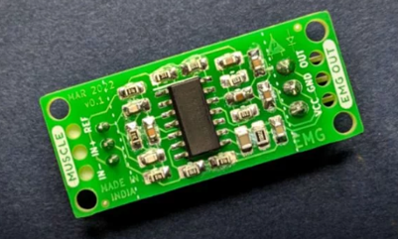
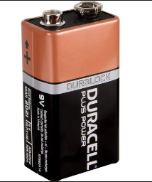
Hardware and Software
Problem Objectives
Hardware
Microcontroller (Arduino Nano): 01 Quantity | Servo Motor: 06 Quality | 3D Printed Prosthetic Arm | Muscle BioAmp: 01 Quality | batteries (170 mAh): 02 Quality | Material Identified for 3D printing
ATmega328: Operation Voltage: 5V Current: 20-50mA Pins: Analog Input Pins (8), PWM Digital I/O Pins (14) SRAM: 2 KB EEPROM: 1 KB. | Tower Pro MG995 digi high speed Servo: Operation Voltage :4.8-7.2V Dead Band Width: 5µs Weight: 55g | Prosthetic Arm: Weight: 838gm Height: 50cm Diameter: 9 cm Material Type: PLA or PETG | Muscle BioAmp: Operation voltage: 3.3V Electrodes: 3 (Positive, Negative, and Reference) Bandpass filter: 72 – 720 Hz | Alkaline batteries: Normal Voltage: 9V Battery Capacity: 170mAh Operating temperature range -20ºC to 54ºC (-4ºF to 130ºF) | Acrylonitrile Butadiene Styrene: Melting point:95-110°C tensile strength: 42MPa Resistance to environmental stress & Crack with high temperature resistance
PROJECT PHASE 2
ATME College of Engineering, Mysuru

Slide 23
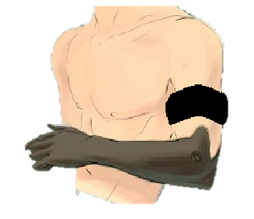
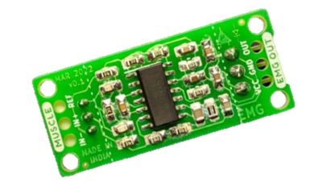
Methodology
5V Power Supply
Bio Amp Suite
BioAmp Suite
Prosthetic Arm
Arduino Nano
Muscle BioAmp
12V Power Supply
Servo MG995
PROJECT PHASE 2
ATME College of Engineering, Mysuru

Slide 24
Flowchart
Objective 1:
Display Error in serial monitor
Arduino
Generate analog data from reference voltage
No
Electrode Detected
Yes
Start
Read signal from EMG Electrode
Second-order band-Pass Butterworth IIR digital filter
Generate frequency with aptitude in dB from IIR filter
Servo rotation & display value in serial monitor
PROJECT PHASE 2
ATME College of Engineering, Mysuru

Slide 25
Flow chart
Objective 2:
Load the hand detector and Initialize camera
Is Camera connected
Get Height and width of frame from the camera
Start
Is Image Displayed
Is Hand Found?
Exit
Display RGB image Or the length of the Hand
Get the distance between the points using distance between 3D vector formula
Convert points from pixels to cm
Extract required points from the “lmList” from CVzone
Detect Hand using openCV
PROJECT PHASE 2
ATME College of Engineering, Mysuru

Slide 26
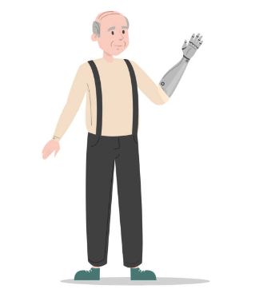
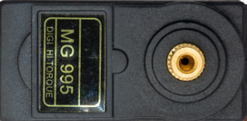
Circuit Diagram
Vcc
GND
Muscle BioAmp
Arduino Nano
Prosthetic Arm
Vcc
GND
Servo MG995
PROJECT PHASE 2
ATME College of Engineering, Mysuru

Slide 27
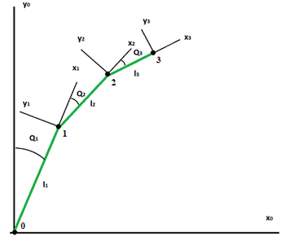
Calculations
Servo Motor Rotation Calculation
Little Finger: 0-90 Degree
Ring Finger: 0-90 Degree
Middle Finger: 0-90 Degree
Fore Finger: 0-90 Degree
Thumb: 0-90 Degree
Example:
Taking Calculations of Folding and Relaxing Hand, Let say Folding hand is 20 and Relaxing hand is 10, Then the difference between both Results is 10.
So, Dividing the Result with 90 degree, we get 9 degree per angle.
PROJECT PHASE 2
ATME College of Engineering, Mysuru

Slide 28
Calculations
Battery Usage Hour Calculation
We are using 3 different 3800mAh batteries in series,
$$Battery Capacity=3∗3800mAh$$
$$=11400mAh$$
$$Current drawn=Arduino Nano \left(20mA per I/O Pin\right)+Servo motor \left(500mA Per Servo\right)$$
$$=20∗6+500∗5$$
$$=2620mA$$
$$Battery Usage Hours= \frac{\text{Battery} \text{Capacity}\text{ (}\text{mAh}\text{)}}{\text{Current} \text{Draw}\text{ (}\text{mA}\text{)}}$$
$$=\frac{\text{11400} }{\text{2620} }$$
$$=4.35H$$
PROJECT PHASE 2
ATME College of Engineering, Mysuru

Slide 29
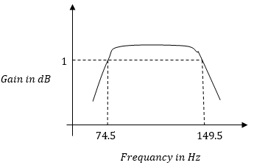
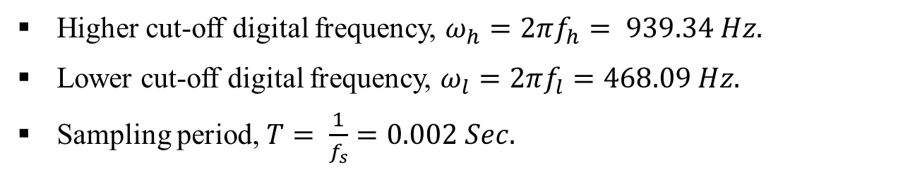
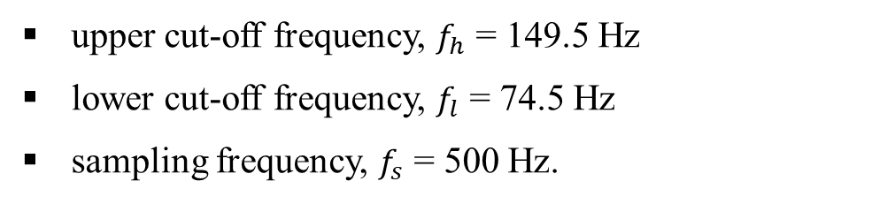
Calculations
Butterworth Band-pass IIR Digital Filter Design
We are using second order Butterworth Band-pass IIR Digital Filter with an
upper cut-off frequency, $f_{h}$ = 149.5 Hz
lower cut-off frequency, $f_{l}$ = 74.5 Hz
sampling frequency, $f_{s}$ = 500 Hz.
Hence, The digital frequency can be determining as,
Higher cut-off digital frequency, $ω_{h}=2πf_{h}= 939.34 Hz.$
Lower cut-off digital frequency, $ω_{l}=2πf_{l}=468.09 Hz.$
Sampling period, $T= \frac{1}{f_{s}}=0.002 Sec.$
Wave form of Butterworth Band-pass filter
PROJECT PHASE 2
ATME College of Engineering, Mysuru

Slide 30
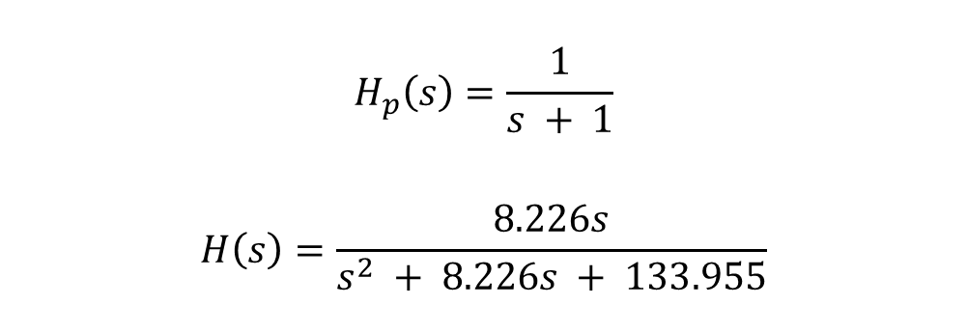

Calculations
This Prototype uses digital IIR lowpass filter to digital IIR band pass filter conversion and the order of the filter design is 4 (i.e. N = 4), Using the second-order sections biquads equation,
$$H_{p}\left(s\right)=\frac{1}{s + 1}$$
$$H\left(s\right)=\frac{8.226s}{s^{2} + 8.226s + 133.955}$$
To get $H\left(s\right)$, replace s by $\frac{s^{2} + ω_{o}^{2}}{sω}$,
By applying Bilinear transformation,
$$H\left(z\right)=\frac{Y\left(z\right)}{X\left(z\right)}=\frac{1 − z^{−1}}{4070.02z^{−2} + 8138.8z^{−1} + 4071.84}$$
The finite difference equation of the filter is found by inverting the transfer function and it given as below,
$$y\left(n\right)=x\left(n\right)−y\left(n−2\right)−2y\left(n−1\right)$$
PROJECT PHASE 2
ATME College of Engineering, Mysuru

Slide 31
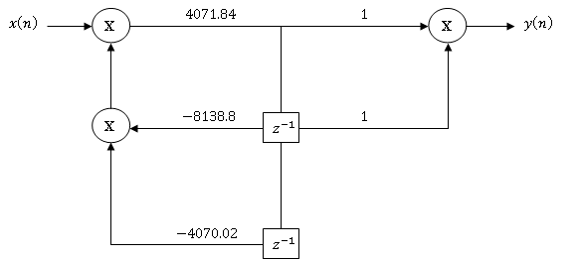
Calculations
The y(n) equation is used for representation of second order Butterworth Band-pass IIR Digital Filter Design in the Arduino programming as represented below:
float output = input;
static float z1, z2;
float x = output - 0.407319594*z1 - 0.81388137*z2;
output = 1.00000000*x + 2.00000000*z1 + 1.00000000*z2;
z2 = z1;
z1 = x;
Direct form II representation
This process will continue up to 4th iteration, for ‘x’ coefficient of ‘z1’ and ‘z2’ which changes from one iteration to another.
PROJECT PHASE 2
ATME College of Engineering, Mysuru

Slide 32
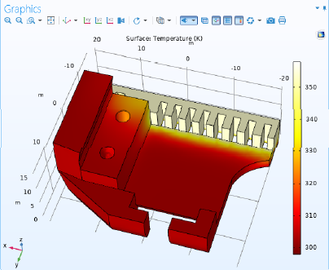
Finite element analysis
Element Temperature analysis using COMSOL application
Finite element analysis of PLA plastic for battery holder with wrist part is as shown.
The red region indicates the possibility of low temperature 300 ºK, and the white region indicates the high temperature 400ºK.
This analysis provides the information about the temperature insulation for the low melting point region.
Procedure of Finite element analysis
Open the Comsol application
Select the material, analysis type (like temperature analysis), stationary analysis, etc..
Import the 3D model
Specifies the conditions
Create the model by creating the analyzer
Finite element analysis
PROJECT PHASE 2
ATME College of Engineering, Mysuru

Slide 33
Work Done in Phase 1 & 2
Phase 1:
Phase 2:
Design and analyze
Finite element analysis
Filter Design
Software design
3D Printing
Application development for objective 2
Arm fabrication
Integration of Software and Hardware
Testing
.Py to .apk conversion in objective 2
PROJECT PHASE 2
ATME College of Engineering, Mysuru

Slide 34
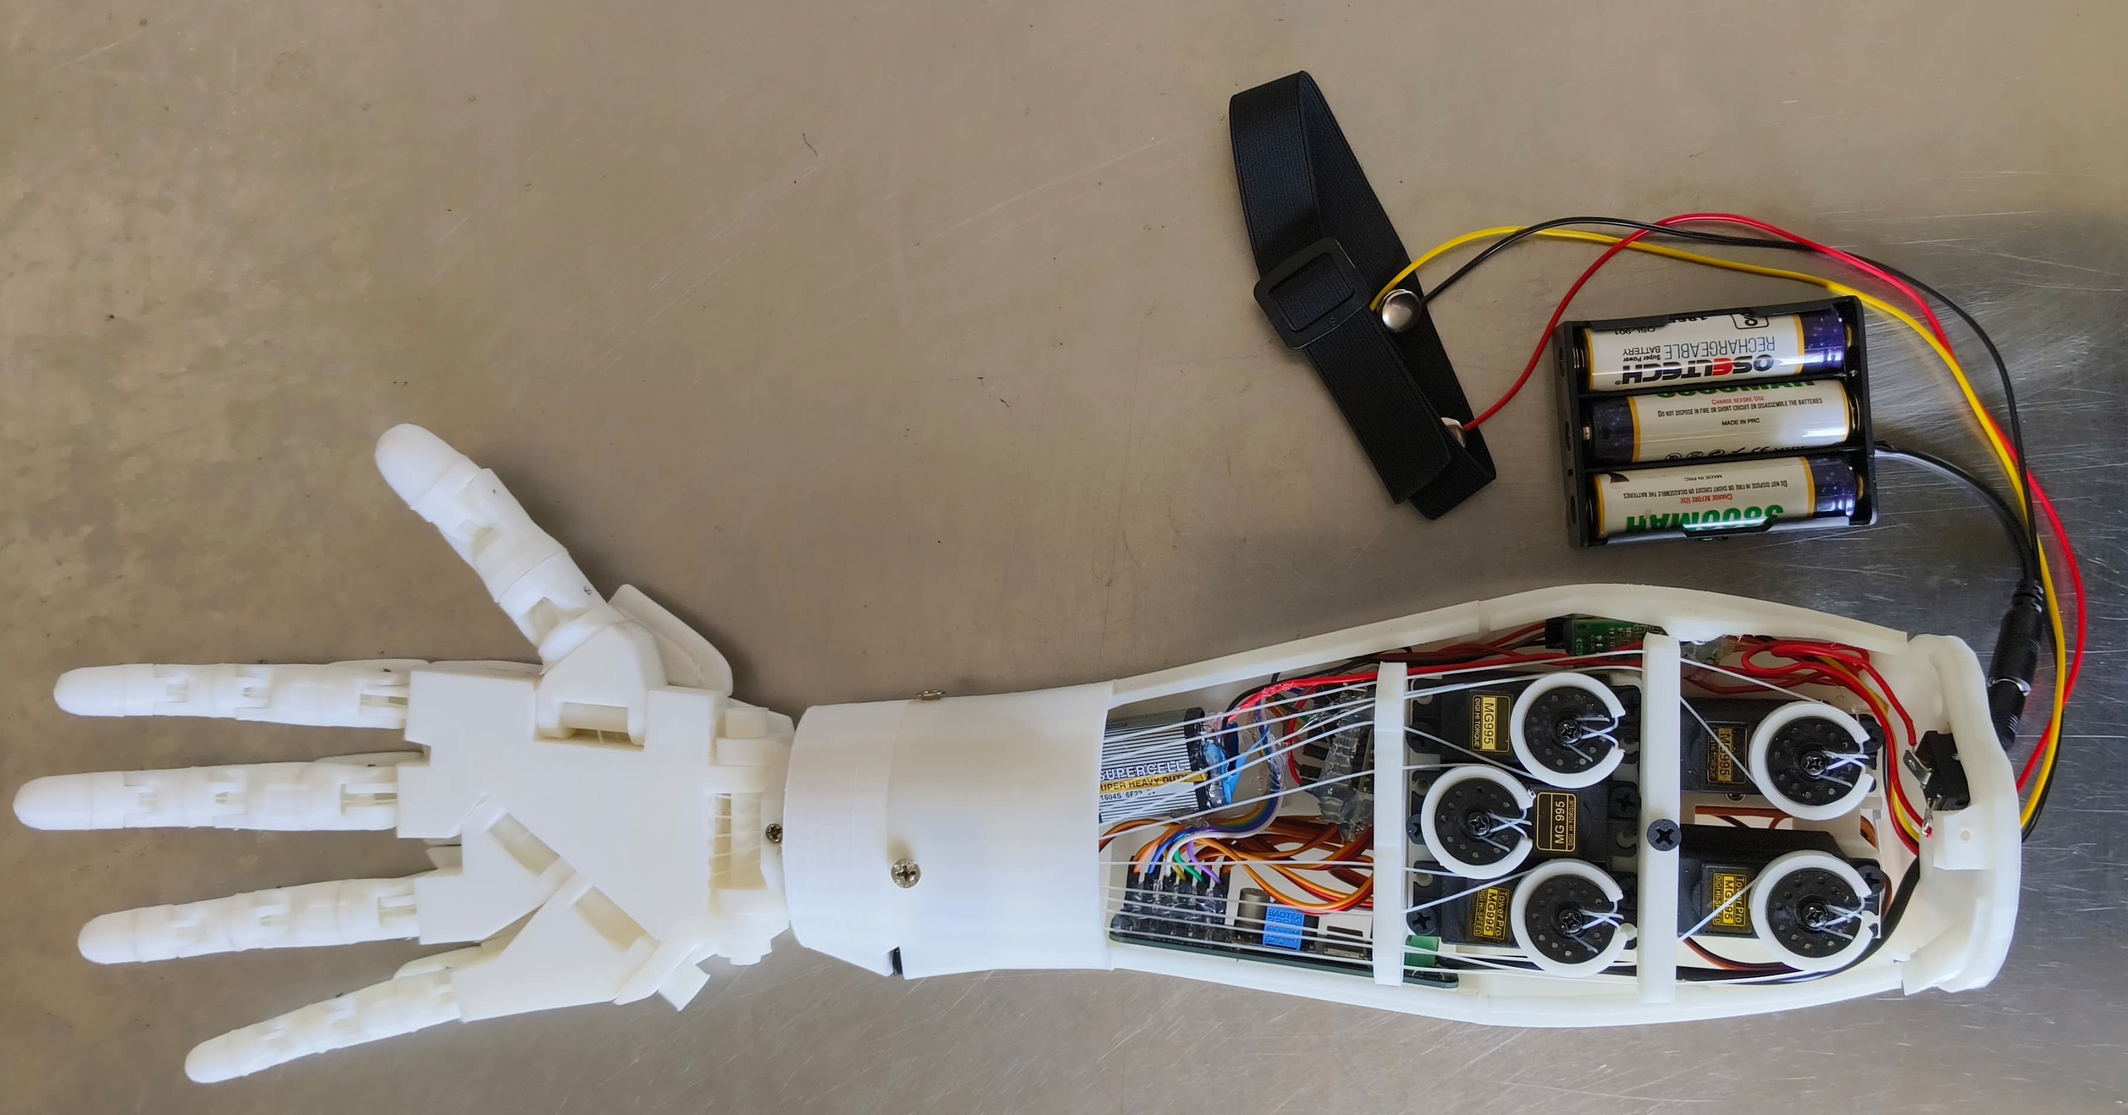
Results
Model with labelling and dimensions:
Electrode
12V Power supply
18 cm
9 cm
Servo MG995
50 cm
Power supply for Arduino
Arduino Nano
Bio Amp
PROJECT PHASE 2
ATME College of Engineering, Mysuru

Slide 35
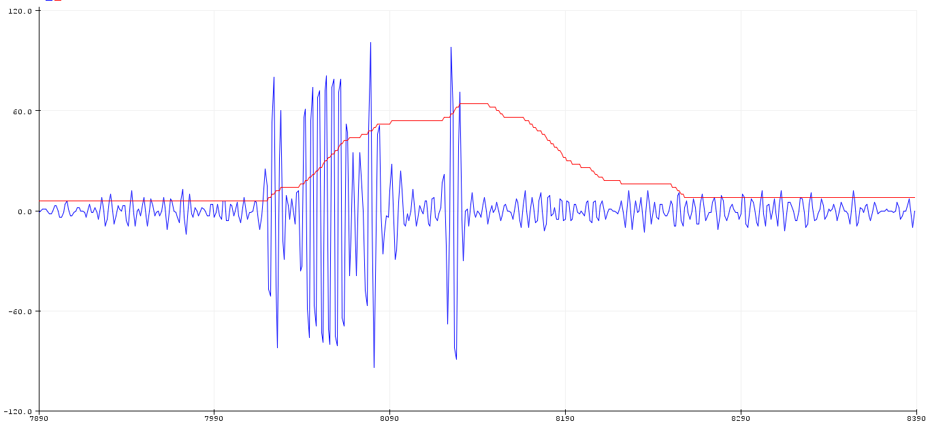
Results
Almost no activity
Active muscle
Frequency of Second-order band-Pass Butterworth IIR digital filter
Envelop Signal
PROJECT PHASE 2
ATME College of Engineering, Mysuru

Slide 36
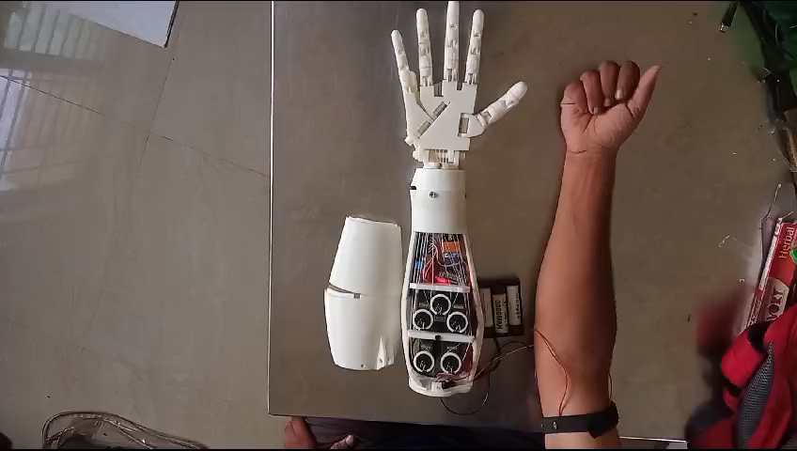
Results
Model demo video:
PROJECT PHASE 2
ATME College of Engineering, Mysuru

Slide 37
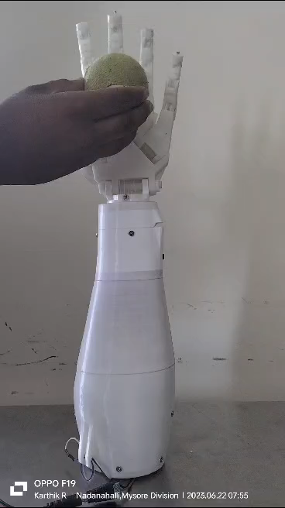
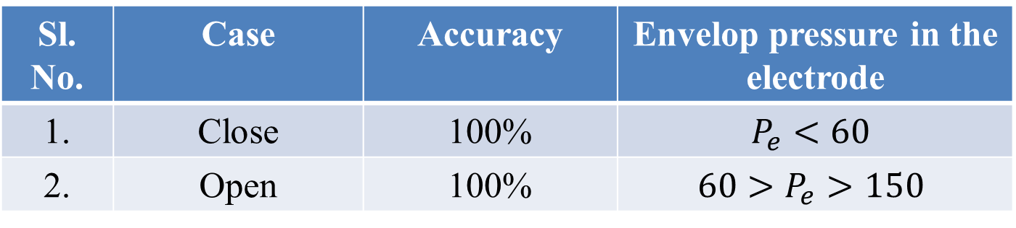
Results
Accuracy Level of the model:
Sl. No. | Case | Accuracy | Envelop pressure in the electrode
1. | Close | 100% | $$P_{e}<60$$
2. | Open | 100% | $$60>P_{e}>150$$
PROJECT PHASE 2
ATME College of Engineering, Mysuru

Slide 38
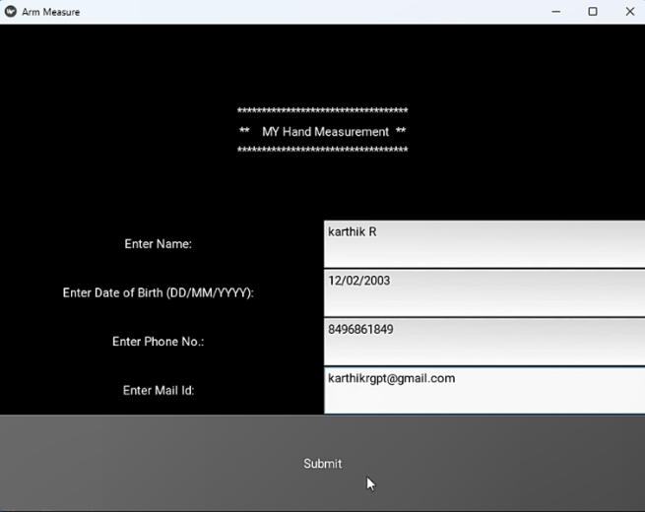
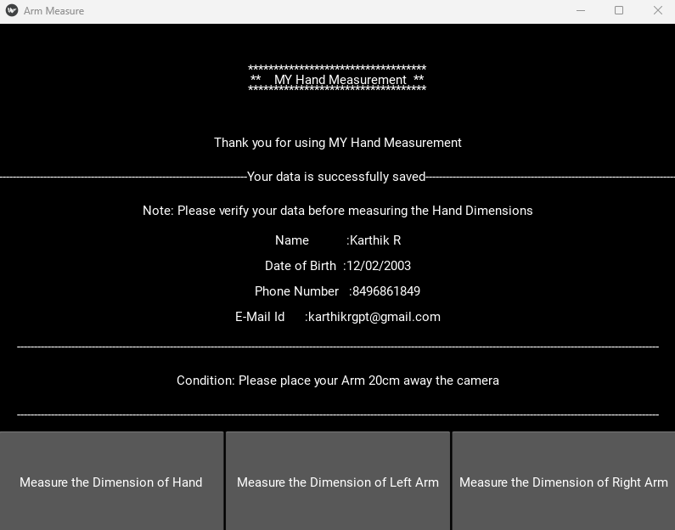
Results
Objective 2:
User need to enter the basic details as shown below:
PROJECT PHASE 2
ATME College of Engineering, Mysuru

Slide 39
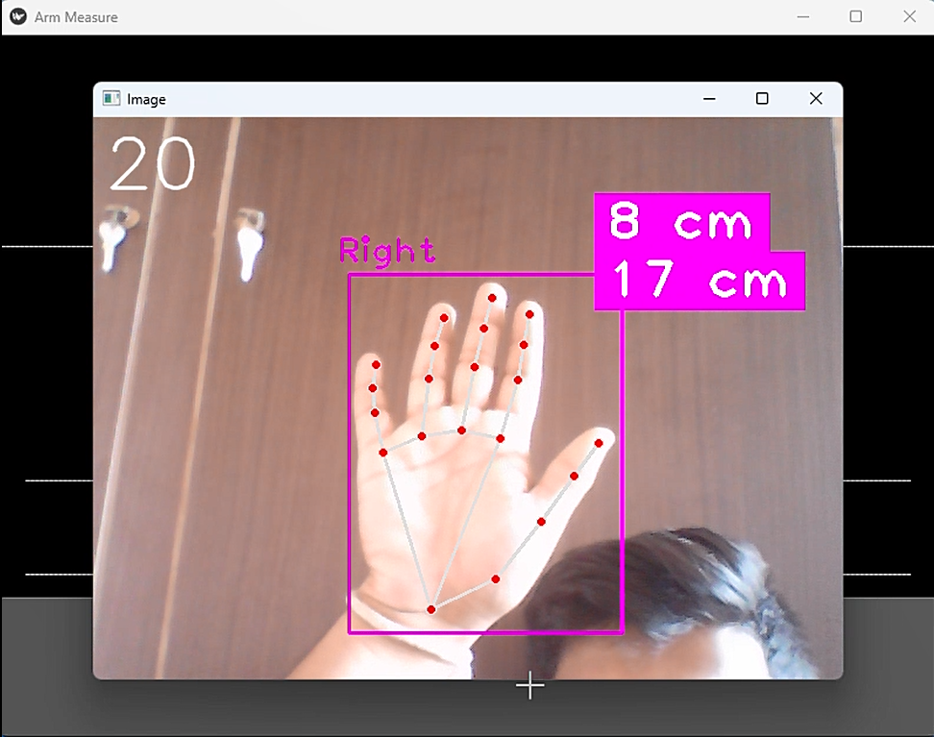
Results
Objective 2:
The Length of the Hand will display in the camera window
Distance between Camera and Hand
Width
Height
PROJECT PHASE 2
ATME College of Engineering, Mysuru

Slide 40
Applications and Advantages
Advantages:
Customizability
Affordability
Speed
Lightweight
Versatility
Applications:
Greater mobility and independence
Cost-effective
Customization
Enhanced functionality
Improved aesthetics
PROJECT PHASE 2
ATME College of Engineering, Mysuru

Slide 41
Applications and Advantages
Advantages:
Customizability
Affordability
Speed
Lightweight
Versatility
Applications:
Greater mobility and independence
Cost-effective
Customization
Enhanced functionality
Improved aesthetics
PROJECT PHASE 2
ATME College of Engineering, Mysuru

Slide 42
Conclusion
Based on the objectives planned, the outcomes are achieved;
Objective 1:
In conclusion, Myoelectric prosthetic arms have the potential to significantly improve the lives of transradial amputees.
The Accuracy of the objective 1 which is development of transradial Myoelectric prosthetic arms has a 100% accuracy.
As technology continues to advance, we can expect to see further improvements in these devices, including greater dexterity, improved sensory feedback, increased integration with other wearable devices, and greater durability and longevity.
PROJECT PHASE 2
ATME College of Engineering, Mysuru

Slide 43
Conclusion
Based on the objectives planned, the outcomes are achieved;
Objective 2:
We built the Application which measures the real time length and width of the human hand and arm using CVZone and PyCharm.
The Accuracy of the Objective 1 is around 90-100% for video capturing and 100% accuracy on photo. Using this user can able to measure their Length and width of their hand or arm using their smart phone anywhere.
This makes amputees more comfortable to give their arm measurement using their smart phone before going to adoption of prosthetic arm which reduce the time for manufacturing of Prosthetic arm.
PROJECT PHASE 2
ATME College of Engineering, Mysuru

Slide 44
Future Scope of Improvement
The future scope of our development is as followed below;
Force and Tactile sensor can be used for better grip.
Integration of AI for classification and identification of different objects which improves grasping power.
Individual finger actuation can be done.
The battery can be upgraded to increase the battery life of the model.
PROJECT PHASE 2
ATME College of Engineering, Mysuru

Slide 45
Budget
Sl.no | Description | Budget
1. | Electric circuit design | 6,000
2. | Sensors and Actuators (Bio Amp, Servo Motors etc) | 4,000
3. | Mechanical Design: 3D Printing | 3,500
4. | Report | 3,000
5. | Miscellaneous | 2,000
 | Total | 18,500
PROJECT PHASE 2
ATME College of Engineering, Mysuru

Slide 46
Time Line
Sl. No. | PHASES | SEP - OCT 2023 | NOV – DEC 2023 | JAN – FEB 2023 | MAR - APL 2023
1 | Project Feasibility Study
2 | Time schedule and analysis
3 | Requirement analysis
4 | Component Availability and Purchase
5 | Design & Implementation of Prosthetic arm
6 | Testing of Prosthetic arm
7 | Final Testing and Analysis
8 | Report Documentation
PROJECT PHASE 2
ATME College of Engineering, Mysuru

Slide 47
References
[1] | CORTICAL CORRELATES OF VOLUNTARY POSTURAL SWAY WITH VIBROTACTILE FEEDBACK IN TRANSFEMORAL AMPUTEES by Aayushi Khajuria. Published: 2023 from IIT Delhi.
[2] | Thumb Controlled Low-Cost Prosthetic Robotic Arm by Amit Hasan Khan, Fairoz Nower Khan, Lamiah Israt, Md. Saiful Islam. Published: 2019 from IEEE .
[3] | Design aspects of a low-cost prosthetic arm for people with severe movement disabilities by Tomasz Kocejko, Radosław Weglerski, Tomasz Zubowicz, Jacek Ruminski, Jerzy Wtorek, Krzysztof Arminski. Published: 2020 from IEEE.
[4] | A 3D-printable Prosthetic Hand Based on a Dual-arm Operation Assistance Model by Taro Shibanoki, Kosuke Jin. Published: 2021 from IEEE.
[5] | Stiffness Perception using Transcutaneous Electrical Stimulation during Active and Passive Prosthetic Control by Luis Vargas, Helen Huang, Yong Zhu, and Xiaogang Hu. Published: 2020 from IEEE.
[6] | A Prosthetic Gripper with Three Opposing Fingers Driven by a Hydraulic Actuator by Yuma Yamanaka and Masahiro Yoshikawa. Published: 2020 from IEEE.
[7] | Robotic Arm controlled using IoT application by H. Kareemullaha, D. Najumnissaa, M.S. Murshitha Shajahana, M. Abhineshjayramb, Varshan Mohanc, S. Ayisha Sheerin. Published: 2022 from Elsevier.
[8] | Design and Testing of a Novel, High-Performance Two DoF Prosthetic Wrist by Revanth Damerla, Kevin Rice, Daniel Rubio-Ejchel, Maurice Miro, Enrico Braucher, Juliet Foote, Issam Bourai, Aaryan Singhal, Kang Yang, Hongju Guang, Vasil Iakimovitch, Evelyn Sorgenfrei, Shorya Awtar. Published: 2020 from IEEE.
[9] | Testing and evaluation of lower limb prosthesis prototypes in people with a transfemoral amputation: a scoping review on research protocols by Vera G. M. Kooiman, Eline S. van Staveren, Ruud A. Leijendekkers, Jaap H. Buurke, Nico Verdonschot, Erik C. Prinsen and Vivian Weerdesteyn. Published: 2023 from Journal of Neuro Engineering and Rehabilitation.
[10] | Cognitive Workload Assessment of Prosthetic Devices: A Review of Literature and Meta-Analysis by Junho Park, and Maryam Zahabi. Published: 2020 from IEEE.
PROJECT PHASE 2
ATME College of Engineering, Mysuru

Slide 48
References
https://docs.scipy.org/doc/scipy/reference/generated/scipy.signal.butter.html
https://courses.ideate.cmu.edu/16-223/f2020/Arduino/FilterDemos/filter_gen.py
https://upsidedownlabs.tech/
PROJECT PHASE 2
ATME College of Engineering, Mysuru

Slide 49

PROJECT PHASE 2
ATME College of Engineering, Mysuru

